Slide 1
ARRAY NINJAS
Inventory Management System
Java-Based Product Stock Control Program
PRESENTED BY
Devi Swathi S
Mohan
Prasanakumar
Yokesh
Version 2.0

Slide 2
PROJECT OVERVIEW
OBJECTIVE
Create a Java program to manage product stock, update quantity, and display low stock alerts using arrays.
Product Management
Stock Updates
Low Stock Alerts
Add, search, and remove products using parallel arrays to store ID, name, quantity and price.
Add, remove or set exact stock quantities with validation and instant feedback.
Automatic alerts when stock falls at or below threshold (≤10) or reaches zero.

Slide 3
PROGRAM STRUCTURE & DATA MODEL
Parallel Arrays (Max 100 Products)
Key Constants & Helpers
productIds[]
int
MAX_PRODUCTS
= 100
Unique product identifier
Max inventory capacity
productNames[]
String
LOW_STOCK_THRESHOLD
= 10
Name of the product
Alert trigger level
quantities[]
int
productCount
= int
Current stock count
Tracks current product total
prices[]
double
Scanner sc
= static
Price in Rupees (Rs.)
Shared input reader

Slide 4
CORE FUNCTIONS — Add & Display Products
addProduct() — Menu Option 1
displayAllProducts() — Menu Option 2
1. Check if inventory is full (MAX 100)
2. Read product ID — validate no duplicate
3. Read name, quantity, and price via input helpers
4. Store values into parallel arrays at productCount index
5. Increment productCount, show success message
6. Immediately call checkLowStock() on new item
1. Check if productCount == 0, show info message
2. Print formatted table header row
3. Loop through all products (0 to productCount)
For each: determine status label —
qty == 0 → OUT OF STOCK
qty ≤ 10 → LOW STOCK
otherwise → OK
Print totals footer after loop

Slide 5
CORE FUNCTIONS — Update Quantity & Search
updateQuantity() — Menu Option 3
searchProduct() — Menu Option 4
Find product by ID using findIndexById()
Show current product name and quantity
Offer 3 sub-actions:
[1] Add stock → quantities[idx] += amount
[2] Remove stock → check underflow first
[3] Set exact → quantities[idx] = amount
Validate non-negative input before applying
Re-run checkLowStock() after update
Two search modes offered:
[1] By ID — calls findIndexById(id)
[2] By Name — case-insensitive keyword match
ID search finds exact match instantly
Name search loops all products using .contains()
Matching products displayed via printProductDetail()
Shows: ID, Name, Qty, Price, Value, Status

Slide 6
CORE FUNCTIONS — Alerts & Remove
showLowStockAlerts() — Option 5
removeProduct() — Menu Option 6
Loops all products checking quantity levels
qty == 0 → Prints [OUT OF STOCK] label
qty ≤ 10 → Prints [LOW STOCK] label
Each alert shows: ID, Name, and current Qty
If no issues: 'All products sufficiently stocked'
Also triggered automatically by checkLowStock() after add/update operations
Find product index via findIndexById()
Display product name for confirmation
Prompt user to confirm (y/n)
If confirmed — shift all elements left:
productIds[i] = productIds[i+1], etc.
Decrement productCount
If cancelled — print 'Removal cancelled'

Slide 7
HELPER METHODS & INPUT VALIDATION
findIndexById(int id)
readInt(String prompt)
Loops through productIds[] array
Returns array index when id matches
Returns -1 if product not found
Used by: update, search, remove functions
Displays prompt and reads a line of input
Uses Integer.parseInt() to convert
Catches NumberFormatException on invalid input
Loops until a valid integer is entered
readDouble(String prompt)
seedDemoData()
Same loop pattern as readInt()
Uses Double.parseDouble() for decimal values
Used exclusively for price input
Re-prompts on any non-numeric entry
Loads 7 demo products on program startup
Calls addProductDirect() to bypass Scanner
Includes mixed stock levels (0, low, normal)
Demo includes: Laptops, Mouse, Monitor, etc.

Slide 8
SUMMARY & DEMO DATA
FEATURES IMPLEMENTED
PRE-LOADED DEMO PRODUCTS
✔ Add Product with duplicate ID check
ID | Product | Qty
101 | Laptop - Dell XPS 15 | 45
102 | Wireless Mouse | 8 ⚠
103 | USB-C Hub 7-in-1 | 22
104 | Mechanical Keyboard | 0 ✗
105 | 27in Monitor - LG | 15
106 | Webcam 1080p | 5 ⚠
107 | Laptop Stand - Aluminium | 30
✔ Display all products with status
✔ Update stock (add / remove / set)
✔ Search by ID or keyword
✔ Low stock & out-of-stock alerts
✔ Remove product with confirmation
✔ Input validation (no crash on bad input)
⚠ = Low Stock ✗ = Out of Stock
Array Ninjas | Inventory Management System v2.0 | Java Programming Project

Slide 9
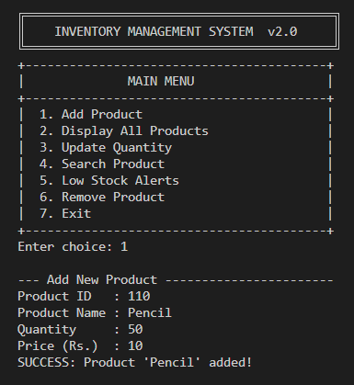
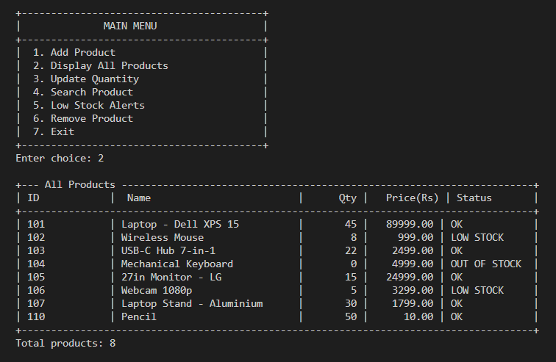
OUTPUT

Slide 10
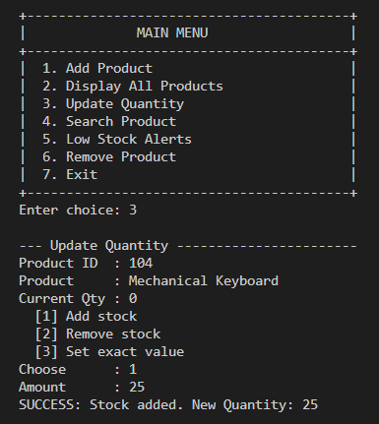
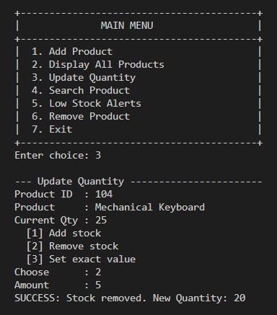
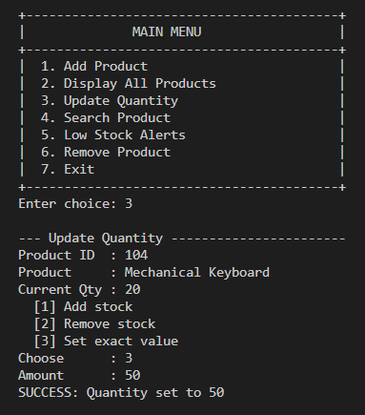
OUTPUT

Slide 11
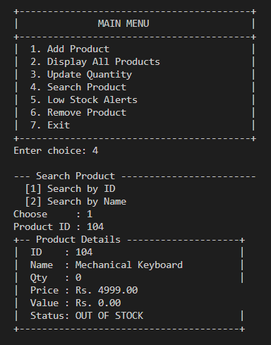
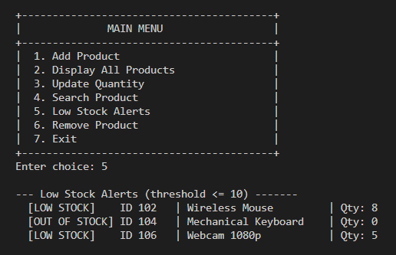
OUTPUT

Slide 12
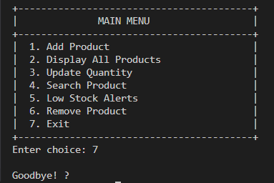
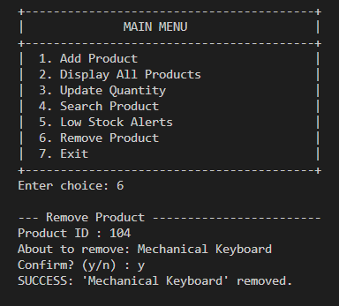
OUTPUT

Slide 13
THANK YOU

